Slide 1
When Small Choices Have Big Impact: Handling Categorical Predictors in Lasso Regression
Amanda Kay Montoya
Charlotte Huang
Quantitative Psychology Brownbag
April 1st, 2019
UCLA

Slide 2

Overview
Motivating Example: Wage data
A Brief Introduction to Lasso Regression
Linear Regression with Categorical Predictors
Lasso Regression with Categorical Predictors
Group Lasso: A complete solution?
Where do we go from here?
This work is lead by Charlotte Huang, but any mistakes or misrepresentations in this presentation are my own.

Slide 3
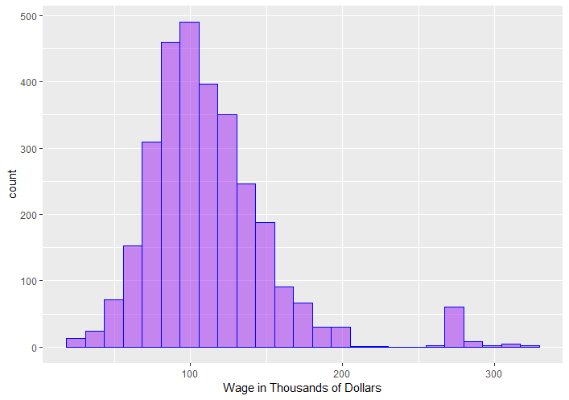
Motivating Example: Wage Data
James, Witten, Hastie, Tishirani (2013) An Introduction to Statistical Learning with Applications in R, Springer.
N = 3000 (All Males in MidAtlantic US)
Variables:
Wage: Worker’s raw wage
Log(Wage): Log of worker’s wage
Year: Year wage info recorded
Age: Age of worker
Race: White, Black, Asian, Other
Job Class: Industrial, Information
Health: <= Good, >= Very Good
Health Insurance: Yes, No
Marital Status: Never married, married, widowed, divorced, separated
Education: < HSGrad, HS Grad, Some College, College Grad, Advanced Degree

Slide 4
Predicting Wage
Goal: Use variables in Wage dataset to predict wage
We might use linear regression to predict wage.
To include the categorical predictors we need to choose a specific coding strategy
Indicator coding/dummy coding
Helmert coding
Sequential coding
Effects coding
Each option has multiple variants
As a starting point let’s choose indicator coding with the first category as the reference (this is the default in R).

Slide 5
Predicting Wage
Goal: Use variables in Wage dataset to predict wage
Linear Regression Results:
Wage increases with year
Wage increases with age
Mixed results for marital status
Mixed results for race
Education seems to increase wage
Information > Industry
Better health, higher wage
No health insurance, lower wage
Predictor |  | Coefficient | Standard Error
Intercept |  | -2423.32 | 616.50
Year |  | 1.24 | 0.31
Age |  | 0.27 | 0.06
Married (vs. Single) |  | 17.18 | 1.72
Widowed (vs. Single) |  | 2.05 | 8.01
Divorced (vs. Single) |  | 3.97 | 2.89
Separated (vs. Single) |  | 11.53 | 4.84
Black (vs. White) |  | -5.10 | 2.15
Asian (vs. White) |  | -2.81 | 2.60
Other (vs. White) |  | -6.06 | 5.67
HS Grad (vs. < HS) |  | 7.76 | 2.37
Some College (vs. < HS) |  | 18.34 | 2.52
College Grad (vs. < HS) |  | 31.24 | 2.55
Advanced Degree (vs. < HS) |  | 53.95 | 2.81
Job Class (Information vs. Industry) |  | 3.58 | 1.32
Health (Very Good vs. Good) |  | 6.51 | 1.42
Health Insurance (No vs. Yes) |  | -17.51 | 1.40
p > .1 | .01< p < .05 | .001<p < .01 | p < .001
16 Predictors
We probably don’t need all of them
Likely overfitting data, which means poor out of sample prediction.

Slide 6
Predicting Wage
Goal: Use variables in Wage dataset to predict wage
Linear Regression Results (Out of Sample Prediction)
Split the data into training set (N = 500) and test set (N = 2500)
Fit linear regression using training set
Examined MSE for test set using the fitted model from training
MSE(linear) = 1197.865 (Average predictions are off by about $34,000)
Can we do better? Would an algorithm like lasso regression do a better job of creating out of sample predictions?

Slide 7
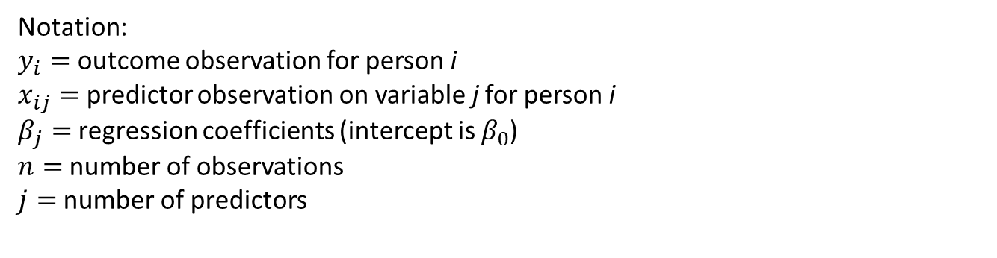
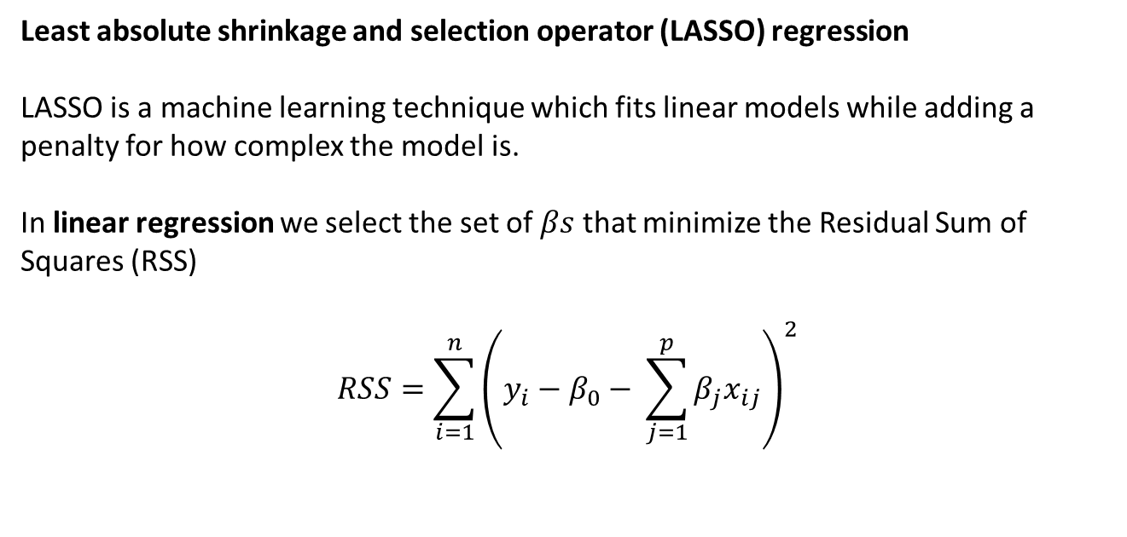
LASSO Regression
Least absolute shrinkage and selection operator (LASSO) regression
LASSO is a machine learning technique which fits linear models while adding a penalty for how complex the model is.
In linear regression we select the set of $βs$ that minimize the Residual Sum of Squares (RSS)
$$RSS=\sum_{i=1}^{n}{{\left(y_{i}−β_{0}− \sum_{j=1}^{p}{β_{j}x_{ij}}\right)}^{2}}$$
Notation:
$y_{i}=$ outcome observation for person i
$x_{ij}=$ predictor observation on variable j for person i
$β_{j}=$regression coefficients (intercept is $β_{0}$)
$n=$number of observations
$j=$number of predictors

Slide 8
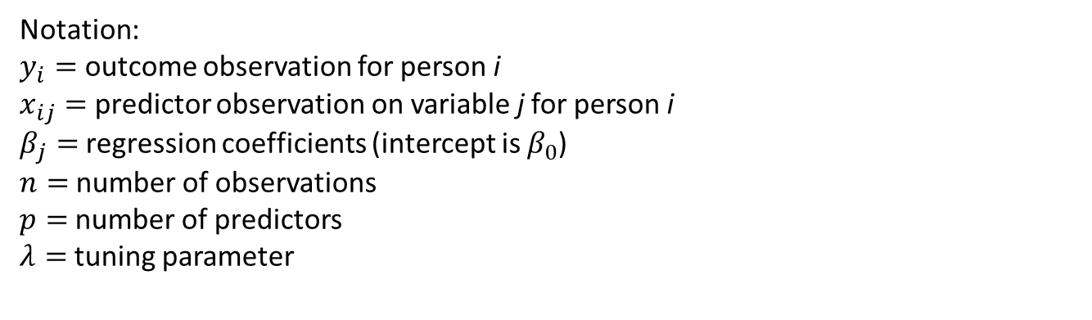
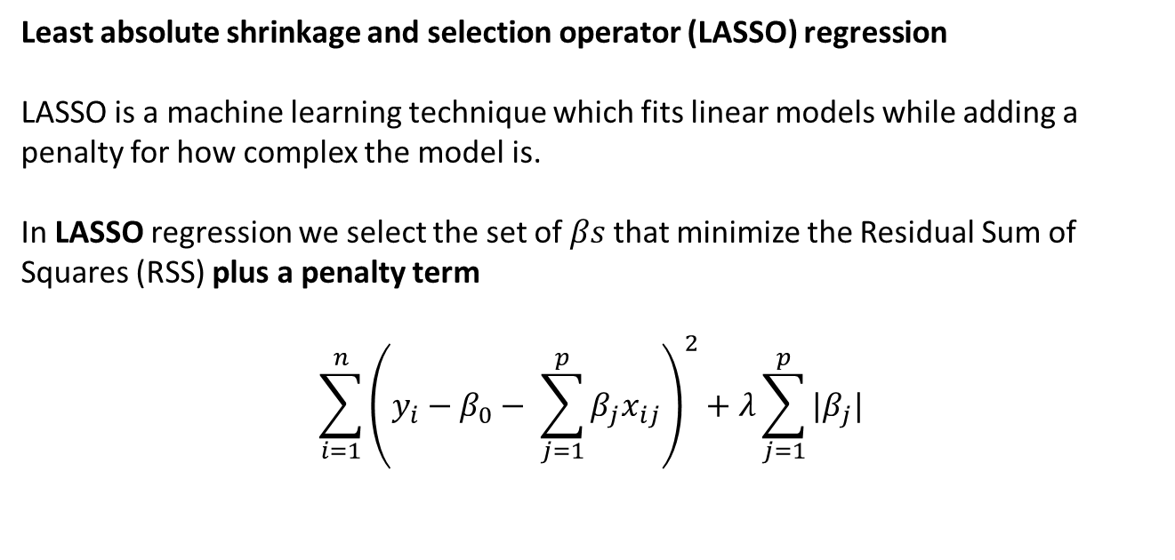
LASSO Regression
Least absolute shrinkage and selection operator (LASSO) regression
LASSO is a machine learning technique which fits linear models while adding a penalty for how complex the model is.
In LASSO regression we select the set of $βs$that minimize the Residual Sum of Squares (RSS) plus a penalty term
$$\sum_{i=1}^{n}{{\left(y_{i}−β_{0}− \sum_{j=1}^{p}{β_{j}x_{ij}}\right)}^{2}+λ\sum_{j=1}^{p}{|β_{j}|}}$$
Notation:
$y_{i}=$ outcome observation for person i
$x_{ij}=$ predictor observation on variable j for person i
$β_{j}=$regression coefficients (intercept is $β_{0}$)
$n=$number of observations
$p=$number of predictors
$λ=$tuning parameter

Slide 9
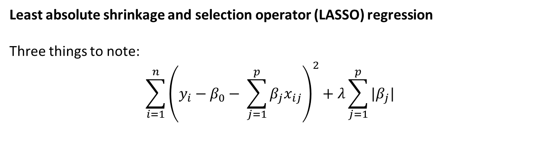
LASSO Regression
Least absolute shrinkage and selection operator (LASSO) regression
Three things to note:
$$\sum_{i=1}^{n}{{\left(y_{i}−β_{0}− \sum_{j=1}^{p}{β_{j}x_{ij}}\right)}^{2}+λ\sum_{j=1}^{p}{|β_{j}|}}$$
(1) The larger the coefficients are, the greater this term will be, so models with slightly smaller coefficients are preferred
(2) The absolute value is the one-dimensional equivalent to a multidimensional function called the l1 norm [this will be important later]
(3) Notice that the intercept is not penalized [also important later (I think)]

Slide 10
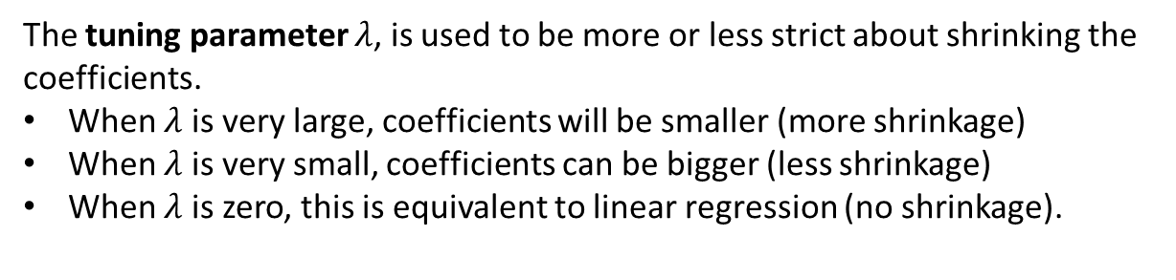
LASSO Regression
LASSO will prefer models with smaller coefficients, leading to some bias is estimates.
This bias in the parameter estimates reduces the variance in the estimates, leading to better prediction (though it’s a little biased).
LASSO regression is very good for variable selection because it shrinks the coefficients closer to zero, and many coefficients become exactly zero or very near zero.
The tuning parameter $λ$, is used to be more or less strict about shrinking the coefficients.
When $λ$ is very large, coefficients will be smaller (more shrinkage)
When $λ$ is very small, coefficients can be bigger (less shrinkage)
When $λ$ is zero, this is equivalent to linear regression (no shrinkage).

Slide 11
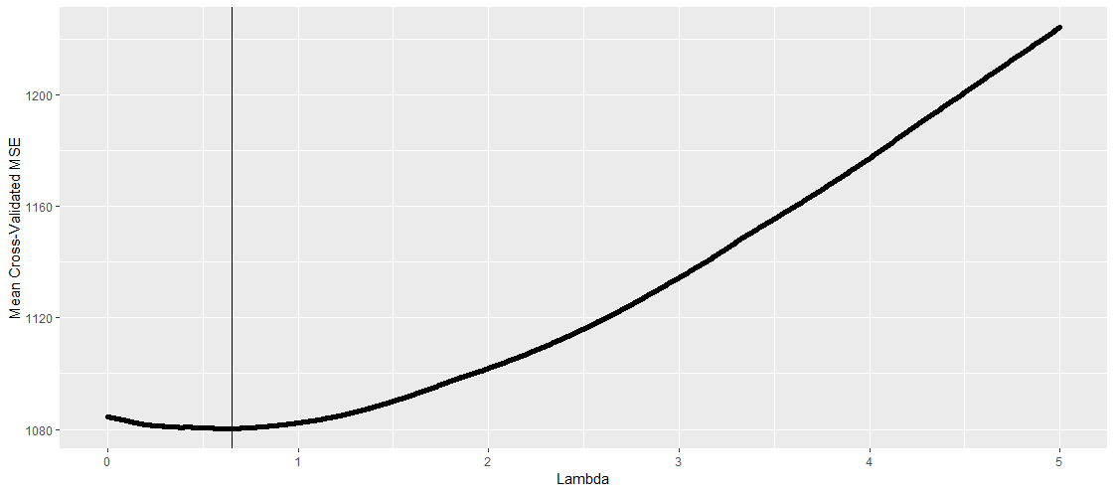
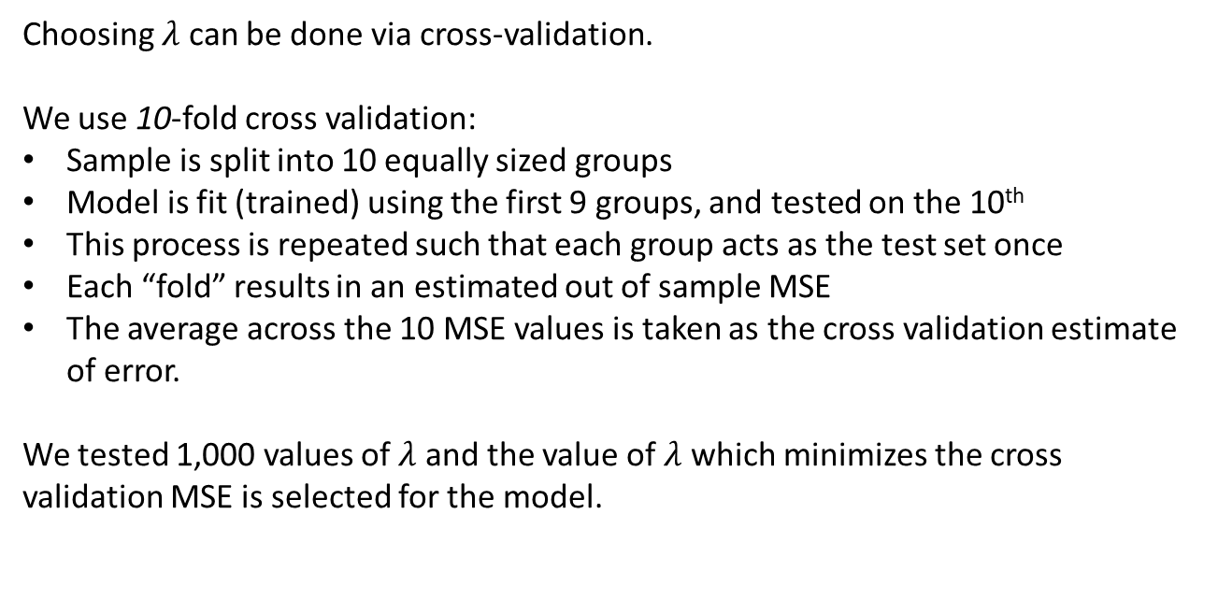
LASSO Regression
Choosing $λ$ can be done via cross-validation.
We use 10-fold cross validation:
Sample is split into 10 equally sized groups
Model is fit (trained) using the first 9 groups, and tested on the 10th
This process is repeated such that each group acts as the test set once
Each “fold” results in an estimated out of sample MSE
The average across the 10 MSE values is taken as the cross validation estimate of error.
We tested 1,000 values of $λ$ and the value of $λ$ which minimizes the cross validation MSE is selected for the model.

Slide 12

LASSO Regression
LASSO regression seems like it might do a better job of variable selection and prediction with the wage dataset.
But, we have a lot of categorical predictors: How will that influence how the model works?
Let’s start by thinking about how linear regression works with categorical predictors.

Slide 13
Coding Multicategorical Variables
In a regression analysis all predictors need to be quantitative or dichotomous. So how do we include a multicategorical variable in regression analysis?
If the multicategorical variable has k categories, it can be represented by k-1 dichotomous or continuous variables.
Methods for coding multicategorical variables:
Indicator / Dummy Coding
Sequential Coding
Helmert Coding
Effects Coding
Example of Multicategorical Variables in Psychology:
Ethnicity (e.g., Caucasian, Asian, Hispanic, African, etc.)
Religion (e.g., Christian, Buddhist, Sikh, etc.)
Gender Identity (e.g., female, male, non-binary, genderqueer, etc.)
Conditions in Study
Marital Status (married, single, widowed, divorced)

Slide 14
Indicator Coding
Select one group to be the “reference group,” this group will be compared to all other groups. This group gets a score of zero on variables in the new coded set.
Each other group will then receive a 1 for one of the recoded variables and a zero on all others.
Example: Marital Status (Single = 1, Married = 2, Widowed = 3, Divorced = 4, Separated = 5)
Marital Status | D₁ | D₂ | D₃ | D₄
1 (Si) | 0 | 0 | 0 | 0
2 (M) | 1 | 0 | 0 | 0
3 (W) | 0 | 1 | 0 | 0
4 (D) | 0 | 0 | 1 | 0
5 (Se) | 0 | 0 | 0 | 1
$$Y_{i}=b_{0}+b_{1}D_{1i}+b_{2}D_{2i}+b_{3}D_{3i}+b_{4}D_{4i}+e_{i}$$

Slide 15
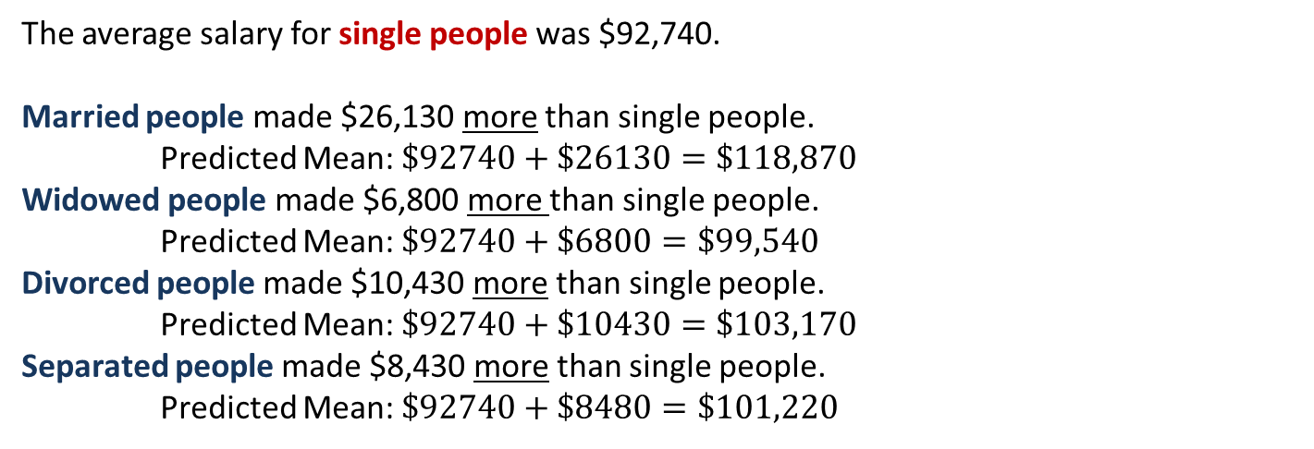
Indicator Coding: Interpreting Regression Results
$$Y_{i}=b_{0}+b_{1}D_{1i}+b_{2}D_{2i}+b_{3}D_{3i}+b_{4}D_{4i}+e_{i}$$
Predictor |  | Coefficient | Standard Error
Intercept |  | 92.74 | 1.58
Married (vs. Single) |  | 26.13 | 1.81
Widowed (vs. Single) |  | 6.80 | 9.37
Divorced (vs. Single) |  | 10.43 | 3.23
Separated (vs. Single) |  | 8.48 | 5.66
p > .1 | .01< p < .05 | .001<p < .01 | p < .001
The average salary for single people was $92,740.
Married people made $26,130 more than single people.
Predicted Mean: $\$92740+\$26130=\$118,870$
Widowed people made $6,800 more than single people.
Predicted Mean: $\$92740+\$6800=\$99,540$
Divorced people made $10,430 more than single people.
Predicted Mean: $\$92740+\$10430=\$103,170$
Separated people made $8,430 more than single people.
Predicted Mean: $\$92740+\$8480=\$101,220$

Slide 16
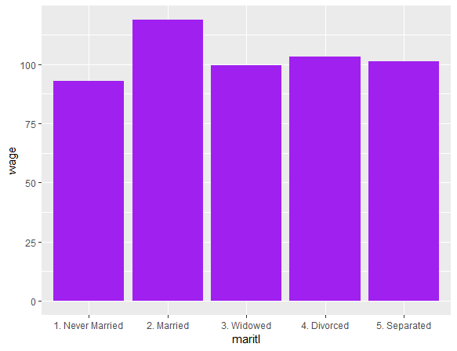
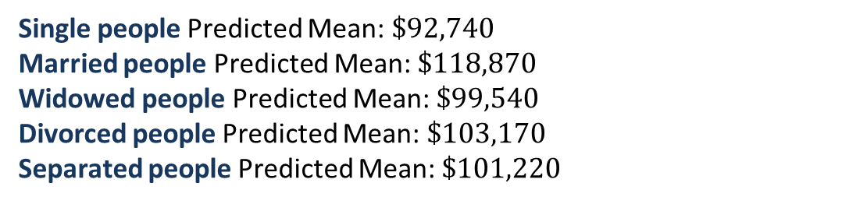
Indicator Coding: Interpreting Regression Results
$$Y_{i}=b_{0}+b_{1}D_{1i}+b_{2}D_{2i}+b_{3}D_{3i}+e_{i}$$
Exact means from the data are recreated when using linear regression.
This is true regardless of coding strategy or choice of reference group.
Single people Predicted Mean: $\$92,740$
Married people Predicted Mean: $\$118,870$
Widowed people Predicted Mean: $\$99,540$
Divorced people Predicted Mean: $\$103,170$
Separated people Predicted Mean: $\$101,220$
118.86
103.16
99.54
101.22
92.73

Slide 17
Sequential Coding
Used for ordered variables, good for examining change in predicted Y with one step increase.
First group gets all zeros. Next group gets 1 on first variable and zeros on all other variables. Second group gets 1’s on first 2 variable and zeros on all others…
Marital Status (Single = 1, Married = 2, Widowed = 3, Divorced = 4, Separated = 5)
Marital Status | S₁ | S₂ | S₃ | S₄
1 (Si) | 0 | 0 | 0 | 0
2 (M) | 1 | 0 | 0 | 0
3 (W) | 1 | 1 | 0 | 0
4 (D) | 1 | 1 | 1 | 0
5 (Se) | 1 | 1 | 1 | 1

Slide 18
Sequential Coding: Predicted Means
Example: Marital Status (Single = 1, Married = 2, Widowed = 3, Divorced = 4, Separated = 5)
Marital Status | S₁ | S₂ | S₃ | S₄
1 (Si) | 0 | 0 | 0 | 0
2 (M) | 1 | 0 | 0 | 0
3 (W) | 1 | 1 | 0 | 0
4 (D) | 1 | 1 | 1 | 0
5 (Se) | 1 | 1 | 1 | 1
Single:
$$\hat{Y_{1}}=b_{0}+b_{1}\left(0\right)+b_{2}\left(0\right)+b_{3}\left(0\right)+b_{4}(0)=b_{0}$$
Married:
$$\hat{Y_{2}}=b_{0}+b_{1}\left(1\right)+b_{2}\left(0\right)+b_{3}\left(0\right)+b_{4}(0)=b_{0}+b_{1}$$
Widowed:
$$\hat{Y_{3}}=b_{0}+b_{1}\left(1\right)+b_{2}\left(1\right)+b_{3}\left(0\right)+b_{4}\left(0\right)=b_{0}+b_{1}+b_{2}$$
Divorced:
$\hat{Y_{4}}=b_{0}+b_{1}\left(1\right)+b_{2}\left(1\right)+b_{3}\left(1\right)+b_{4}\left(0\right)=b_{0}{+ b}_{1}+b_{2}+b_{3}$
Separated:
$$\hat{Y_{5}}=b_{0}+b_{1}\left(1\right)+b_{2}\left(1\right)+b_{3}\left(1\right)+b_{4}\left(1\right)=b_{0}{+ b}_{1}+b_{2}+b_{3} +b_{4}$$
Trust me that this perfect recreates the means just like indicator coding.

Slide 19
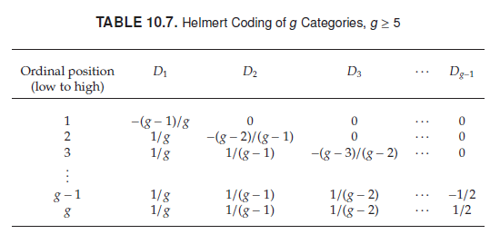
Helmert Coding
Used for ordered variables. Regression coefficients quantify the difference between one group and the average of all subsequent groups.
How to code variables depends on the number of groups.
Hayes & Darlington, 2017 Regression Analysis and Linear Models

Slide 20
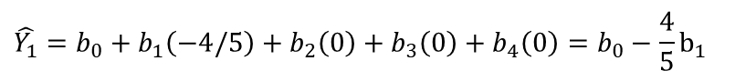
Helmert Coding: Predicted Means
Example: Marital Status (Single = 1, Married = 2, Widowed = 3, Divorced = 4, Separated = 5)
Marital Status | H₁ | H₂ | H₃ | H₄
1 (Si) | -4/5 | 0 | 0 | 0
2 (M) | 1/5 | -3/4 | 0 | 0
3 (W) | 1/5 | 1/4 | -2/3 | 0
4 (D) | 1/5 | 1/4 | 1/3 | -1/2
5 (Se) | 1/5 | 1/4 | 1/3 | 1/2
Single:
$$\hat{Y_{1}}=b_{0}+b_{1}\left(−4/5\right)+b_{2}\left(0\right)+b_{3}\left(0\right)+b_{4}\left(0\right)=b_{0}−\frac{4}{5}b_{1}$$
Married:
$$\hat{Y_{2}}=b_{0}+b_{1}\left(1/5\right)+b_{2}\left(−3/4\right)+b_{3}\left(0\right)+b_{4}\left(0\right)=b_{0}+{\frac{1}{5}b}_{1}−\frac{3}{4}b_{2}$$
Widowed:
$$\hat{Y_{3}}=b_{0}+b_{1}\left(1/5\right)+b_{2}\left(1/4\right)+b_{3}\left(−2/3\right)+b_{4}\left(0\right)=b_{0}+{\frac{1}{4}b}_{1}+\frac{1}{4}b_{2}−\frac{2}{3}b_{3}$$
Divorced:
$\hat{Y_{4}}=b_{0}+b_{1}\left(1/5\right)+b_{2}\left(1/4\right)+b_{3}\left(1/3\right)+b_{4}\left(−1/2\right)=b_{0}{+\frac{1}{5}b}_{1}+\frac{1}{4}b_{2}+{\frac{1}{3}b}_{3}−\frac{1}{2}b_{4}$
Separated:
$\hat{Y_{5}}=b_{0}+b_{1}\left(1/5\right)+b_{2}\left(1/4\right)+b_{3}\left(1/3\right)+b_{4}\left(−1/2\right)=b_{0}{+\frac{1}{5}b}_{1}+\frac{1}{4}b_{2}+{\frac{1}{3}b}_{3}+\frac{1}{2}b_{4}$
Trust me that this perfect recreates the means just like indicator coding.

Slide 21
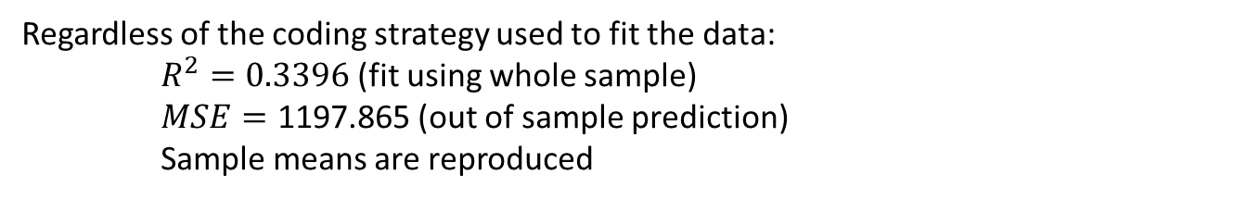
Model Fit (In & Out of Sample)
Regardless of the coding strategy used to fit the data:
$R^{2}=0.3396$(fit using whole sample)
$MSE=\text{1197.865}$ (out of sample prediction)
Sample means are reproduced
118.86
103.16
99.54
101.22
92.73

Slide 22
LASSO with Categorical Variables
Because LASSO is using a penalty for large regression coefficients, and changing coding strategy changes the regression coefficients (and their meaning), we believe that LASSO will be sensitive to the different coding strategies.
Fit Wage Data with a variety of coding strategies and LASSO
Indicator coding with different reference groups
 | Single | Married | Widowed | Divorced | Separated
Intercept | 96.413 | 122 | 98 | 96 | 96
Single | . | -25.65 | 0 | 0 | 0
Married | 24.996 | . | 23.369 | 25.168 | 25.535
Widowed | 10.27 | -4.07 | . | 11.746 | 13.95
Divorced | 0 | -25.14 | 0 | . | 0
Separated | -0.462 | -28 | 0 | -0.8767 | .

Slide 23
LASSO with Categorical Variables
Very different decisions get made about variable selection based on reference group
 | Single | Married | Widowed | Divorced | Separated
Intercept | 96.413 | 122 | 98 | 96 | 96
Single | . | -25.65 | 0 | 0 | 0
Married | 24.996 | . | 23.369 | 25.168 | 25.535
Widowed | 10.27 | -4.07 | . | 11.746 | 13.95
Divorced | 0 | -25.14 | 0 | . | 0
Separated | -0.462 | -28 | 0 | -0.8767 | .
For example, when the widowed group is reference, we would conclude that all other groups are equal to widowed except married.
But for all other reference groups: We conclude the widowed is different from all other groups including married!
Look even closer at the predicted difference between widowed and married in the widow reference model compared to married reference: 23.269 vs. 4.07

Slide 24
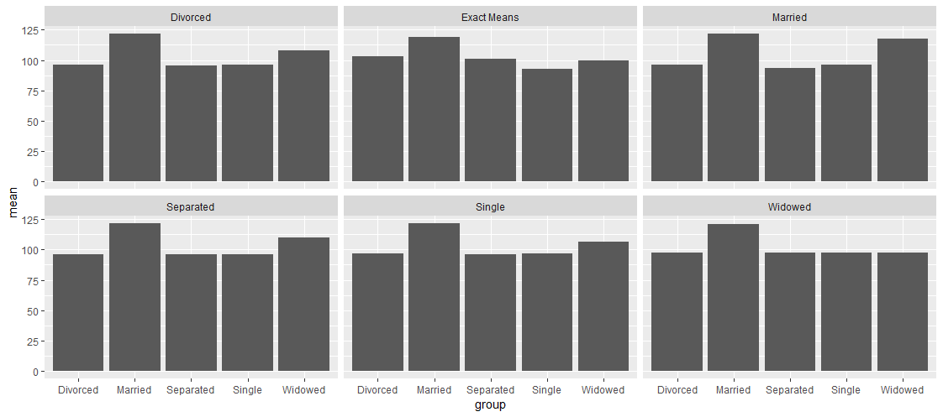
LASSO Group Mean Recovery
MSE = 1619.72 MSE = 1621.942
MSE = 1620.045 MSE = 1547.094 MSE = 1617.636
The predictive ability and ability to recreate means also depends on which reference group is used.

Slide 25
Other Coding Strategies
Charlotte ran a variety of models with different coding strategies (not just indicator coding) and multiple predictors.
Outcome: Wage
Predictors: Marital Status, Race, Education, Job Class, Health, Health Insurance, Age
 | Variable Selection Across Coding Strategies
 | Indicator Coding (1st Category Reference) | Effect Coding | Helmert Coding
Marital Status | 3/4 | 3/4 | 3/4
Race | 2/3 | 2/3 | 3/3
Education | 3/4 | 4/4 | 4/4
Job Class | 1 | 1 | 1
Health | 1 | 1 | 1
Insurance | 1 | 1 | 1
Age | 1 | 1 | 1
MSE | 1201.552 | 1189.692 | 1193.869

Slide 26
LASSO Conclusions
Properties of LASSO regression which vary by coding strategy:
Prediction (model fit)
Group means and differences between group means
Variable selection
Additional concerns:
More complex models with multiple multicategorical variables and other continuous variables
This model was relatively simple, so we could try out many options and choose the model which fits best.
More coding options are available. Different coding strategies can be used for different variables. Can we expect researchers to try all possible?
Can’t we just choose the set of variables (like we can in linear regression) and won’t that fix all our problems?

Slide 27
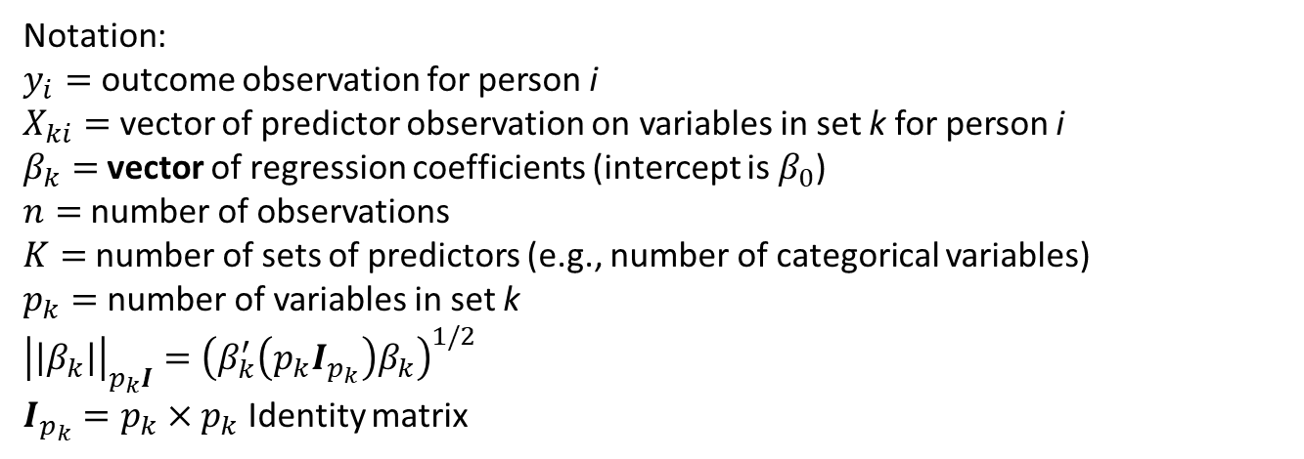
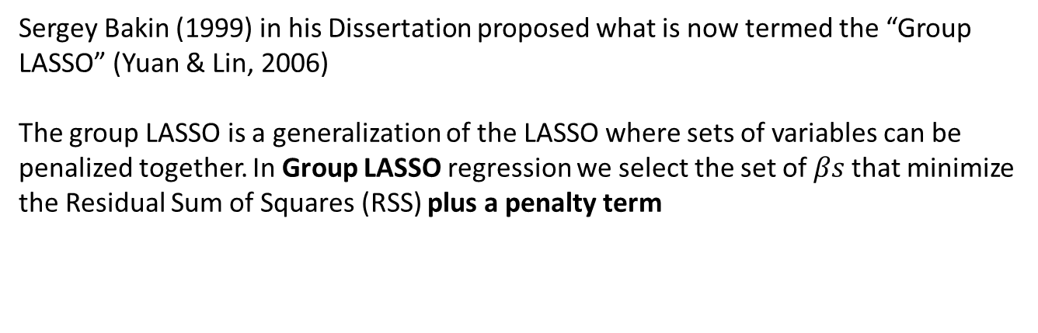
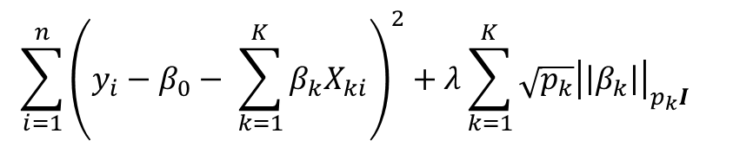
Group LASSO Regression
Sergey Bakin (1999) in his Dissertation proposed what is now termed the “Group LASSO” (Yuan & Lin, 2006)
The group LASSO is a generalization of the LASSO where sets of variables can be penalized together. In Group LASSO regression we select the set of $βs$that minimize the Residual Sum of Squares (RSS) plus a penalty term
$${\sum_{i=1}^{n}{{\left(y_{i}−β_{0}− \sum_{k=1}^{K}{β_{k}X_{ki}}\right)}^{2}+λ\sum_{k=1}^{K}{\sqrt{p_{k}}{\left|\left|β_{k}\right|\right|}_{p_{k}I}}}}_{}$$
Notation:
$y_{i}=$ outcome observation for person i
$X_{ki}=$ vector of predictor observation on variables in set k for person i
$β_{k}=$vector of regression coefficients (intercept is $β_{0}$)
$n=$number of observations
$K=$number of sets of predictors (e.g., number of categorical variables)
$p_{k}=$number of variables in set k
$${\left|\left|β_{k}\right|\right|}_{p_{k}I}={\left(β_{k}^{′}\left(p_{k}I_{p_{k}}\right)β_{k}\right)}^{1/2}$$
$I_{p_{k}}=p_{k}×p_{k}$ Identity matrix

Slide 28
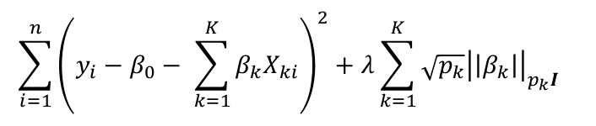
Group LASSO Regression
$${\sum_{i=1}^{n}{{\left(y_{i}−β_{0}− \sum_{k=1}^{K}{β_{k}X_{ki}}\right)}^{2}+λ\sum_{k=1}^{K}{\sqrt{p_{k}}{\left|\left|β_{k}\right|\right|}_{p_{k}I}}}}_{}$$
Penalizes using an l2 norm for variables in the same “set”
Penalizes using an l1 norm for different sets
If all variables are their own set, simplifies to lasso regression
If only one set, simplifies to a ridge regression
Yuan & Lin (2006)

Slide 29
Group Lasso: Variable Selection & Prediction
Charlotte ran a variety of group lasso models with different coding strategies (not just indicator coding) and multiple predictors. All group lasso models included all predictors.
Outcome: Wage
Predictors: Marital Status, Race, Education, Job Class, Health, Health Insurance, Age
 | Variable Selection Across Coding Strategies
 | Indicator Coding (1st Category Reference) | Effect Coding | Helmert Coding
LASSO (MSE) | 1201.552 | 1189.692 | 1193.869
Group LASSO (MSE) | 1193.260 | 1188.600 | 1193.580
In this data, whether we use the group LASSO or lasso doesn’t seem to make much of a difference regarding model fit.
Group LASSO is not susceptible to choosing different variables across coding strategies, but fit still varies.

Slide 30
Group Lasso vs. Lasso
We have a small simulation examining the performance of group lasso and lasso with 1 categorical predictor where 1 group differs from all other groups (dominant category).
Lasso should be preferred in this case because group lasso would need to include multiple variables to capture the variance (likely overfitting), but lasso only needs to include one.
Factors in Monte Carlo Simulation
Group Mean difference
Number of categories
Outcomes:
Inclusion of dominant category
Inclusion of non-dominant categories
Average MSE

Slide 31
Group Lasso vs. Lasso
When mean difference is “small”:
Lasso captures group difference more often than group lasso, particularly for more groups
Group lasso includes other variables in the set
Average fit of the models is similar

Slide 32
Group Lasso vs. Lasso
When mean difference is “medium”:
Lasso capture mean difference more often than group lasso, particularly for more groups
Group lasso includes other variables in the set
Average fit of the models is similar for few groups, but lasso performs better for more groups

Slide 33
Group Lasso vs. Lasso
When mean difference is “large”:
Both methods select variables for group differences
Group lasso includes other variables in the set
Average fit of the models is similar, but seems like group lasso fits slightly worse (perhaps due to overfitting from selecting the rest of the categories and ridge regression vs. lasso)

Slide 34
Conclusions
It’s still unclear how to handle categorical predictors in lasso/group lasso regression:
Both methods are sensitive in some ways to coding scheme
Lasso: Variable selection & Prediction
Group Lasso: Prediction
With proper theory, perhaps the researcher could choose a preferred coding scheme.
With iterative approaches perhaps the best coding scheme for a training dataset could be selected for test dataset
It’s not clear if the coding scheme which optimizes variable selection also optimizes prediction, may depend on patterns of means in the data.
What are the implications for interactions in LASSO?

Slide 35

Thank You
Thanks to Charlotte Huang for leading this project, and providing many resources as I prepared for this presentation. Thanks to Han Du and the Quantitative Brownbag Seminar for allowing me the opportunity to present, and to the UCLA Psychology department for sponsoring my time here. Thanks to the students and colleagues of the Quantitative Research Collaboratory for continuously seeking and searching for new answers to interesting research questions.

Slide 36
Prompting Questions
Do we need to include forward/backward selection?
These would also be “immune” to coding scheme as long as you forward and backward select the set of indicators.
Should the biggest group be estimated as the “reference” group, since that’s a unpenalized parameter?
Should we be fitting models with no intercept? Aren’t we then just forcing all groups into the model?
Could we center the outcome?
Only use effects coding?
How much does sample size matter? Widowed was our smallest group (N = 19) and caused the most problems. Is that a coincidence?
Notes:
Never married (N = 648), Married (2074), Widowed (19), Divorced (204), Separated (55)

